Slide 1
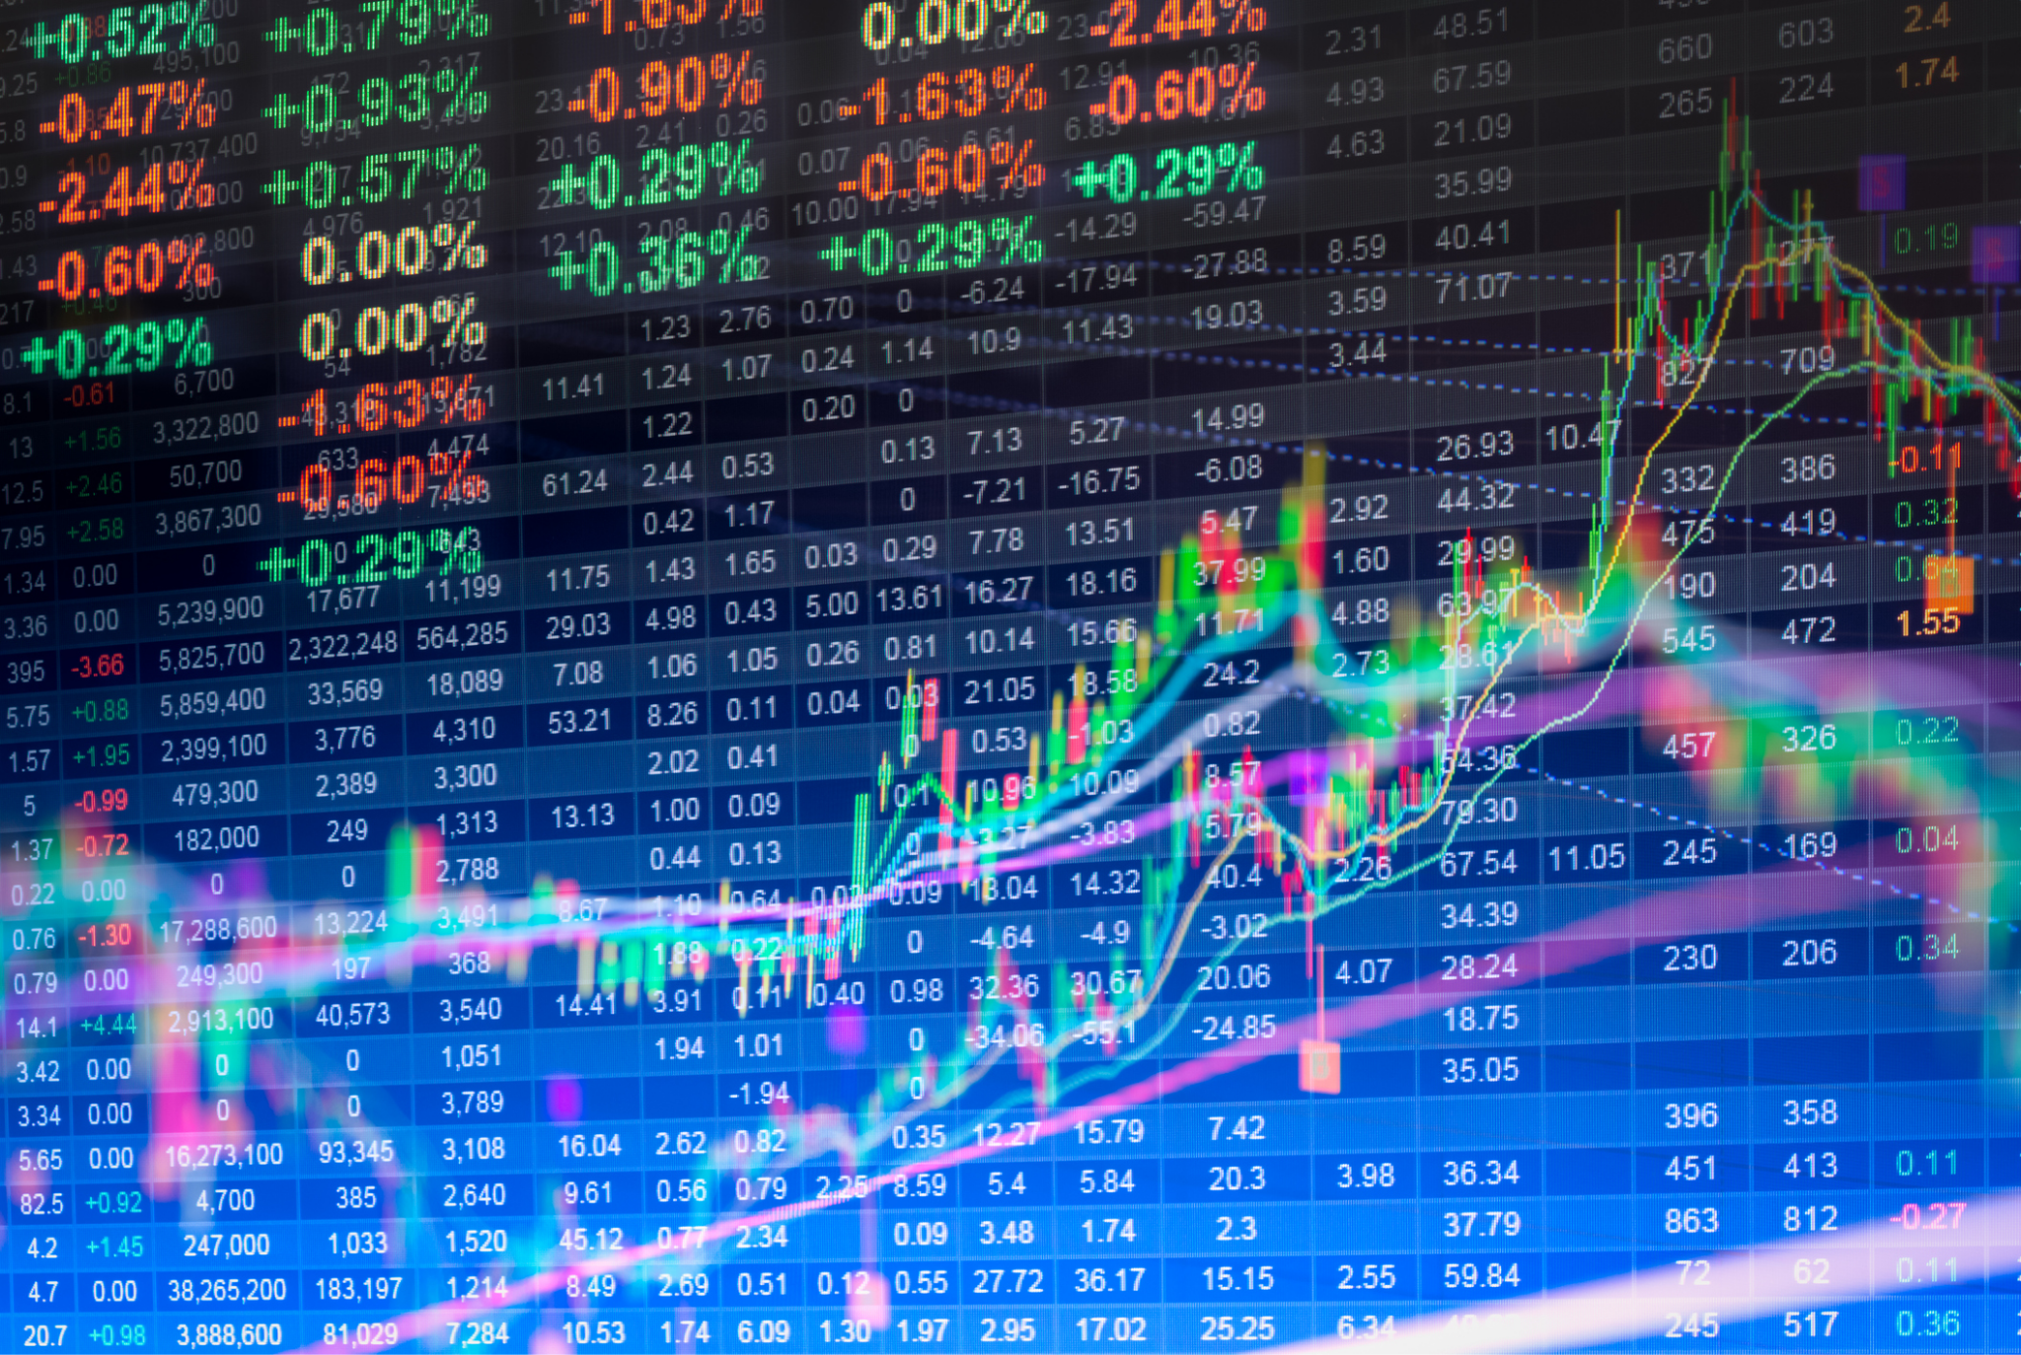
CS561 - Map Reduce and Big Data
Quantitative and Qualitative Analysis of Stocks
Sanskar Gupta (B18140)
Om Pandey (B18182)
Shashank Dwivedi (B18192)
Vishal Kumar Singh (B18150)
Rahul Kumar (B18079)

Slide 2
Quantitative Analysis of Microsoft’s Stocks - Understanding Data
The yFINANCE Python package was used to create the database, which allows users to obtain historical data for tickers.
As a vector, We used [High, Low, Open Close] of Microsoft Stocks over 1000 days.
Example -
Day | OPEN | CLOSE | HIGH | LOW
12/2/2021 | 1222 | 1225 | 1270 | 1211
13/2/2021 | 1223.5 | 1229 | 1265 | 1221

Slide 3
Quantitative Analysis of Microsoft’s Stocks - Results
We compared the closing price of adjacent dates and classified the data in two classes,
Closing price of the next day is greater than the closing price of today.
Closing price of the next day is lower than the closing price of today.
We trained the random forest model using [Open, High, Low, Close] as input
The result (for Microsoft) - 63%
Is this good enough - A little, but not much
Can we improve this accuracy? - That is what this project is about

Slide 4
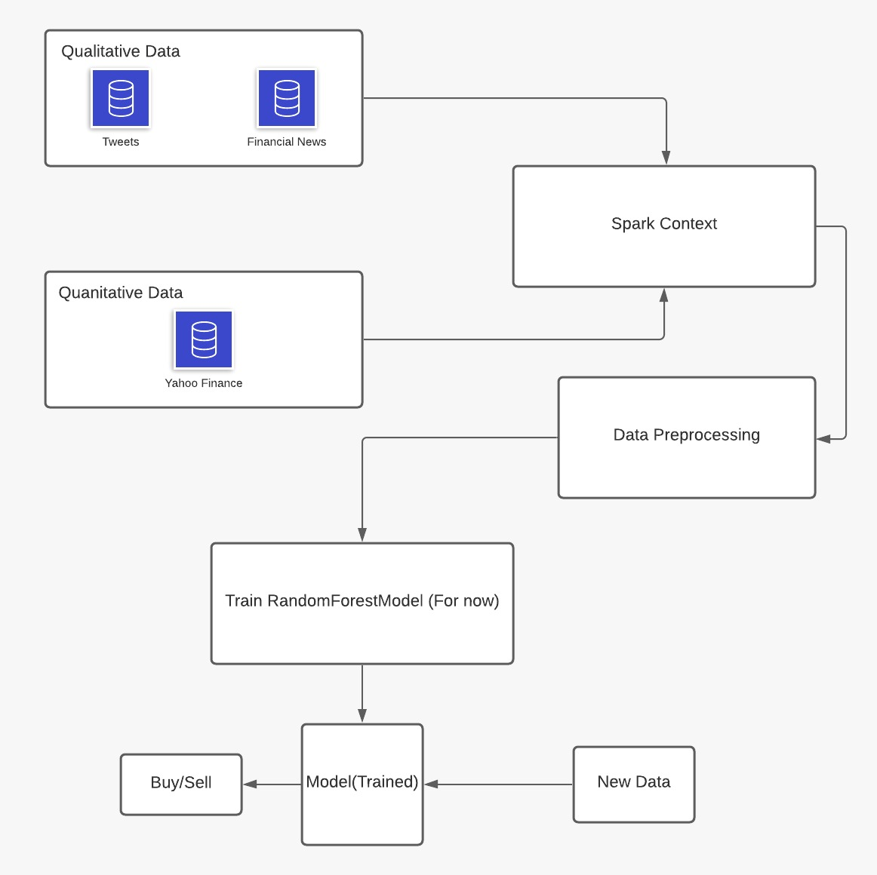
Proposing a Quantitative & Qualitative approach
Quantitative Data Format
Qualitative Data Format
Final Data Format
Date | Open | Close | High | Low
Date | Score
Date | Score | Open | Close | High | Low

Slide 5
Qualitative Analysis of Tweets - Collecting Data
We chose the tweets since the majority of the news headlines were deemed to be neutral during sentiment analysis.
Because the official Twitter API only allows you to gather tweets from the last seven days, we devised a workaround.
To analyse the sentiment of the tweets, we are utilising the Twint library to retrieve the latest 1000 tweets, 100 tweets every day.
Tweets were searched based on “cashtag”, e.g. $msft

Slide 6


Qualitative Analysis of Tweets - Data Preprocessing
The sentiment of each piece of data was analysed using the flair library, which comes pre-loaded with a fantastic sentiment analysis model.
Following example showcases the effectiveness of sentiment analyser-
For qualitative analysis, we computed the average sentiment for each day, multiplied it by -1 if sentiment was negative, and attached the score vector to the previously utilised data.

Slide 7
Quantitative & Qualitative Analysis
The final schema for data looks like this:
On this data, we use the random forest classifier that comes with the pyspark package.
The results show a difference in accuracy of a whopping 11%, with 75% accuracy
Date | Open | Close | High | Low | Score
12/02/2021 | 1222 | 1255 | 1285 | 1212 | -0.874
13/02/2021 | 1223.5 | 1254.2 | 1256 | 1201 | 0.366

Slide 8
Is this really Big Data?
We're now utilising 1000-day tweets, with 100 tweets every day.
This daily limit of 100 tweets is a constraint for our machines, since scraping only this takes roughly 3.5 hours.
With the correct resources, this number may reach tens of thousands of tweets every day.
Even if that is accomplished, we have employed the pyspark module, ensuring that our code is scalable and capable of processing that volume of data.
Apart from the SQL context, which stores data, Spark also includes libraries that are built to manage large amounts of data, one of which we have employed.

Slide 9
Results across various companies
Company Name | Accuracy (Without tweets) | Accuracy (With tweets)
Microsoft | 64 | 75
Reliance Industries | 71.8 | 76
Tesla | 65.7 | 74.5

Slide 10
Challenges and Limitations
Data fetching takes a lot of time (around 3.5 hours)
Sometimes the scraper fails to load old tweets.
Cashtags aren’t used extensively by Indian stocks as compared to NASDAQ.
Scrapper shows 403 error occasionally.

Slide 11
Moving Forward - What’s ahead?
Our original aim was to link standard techniques such as bollinger bands and moving averages with this model later.
We were unable to test models other than the random forest classifier, so there is room for improvement there as well.
The labels were created with short-term trading in mind, but users may also choose the amount of days they want to trade for.
A user friendly interface can be created.

Slide 12
Thank You
Any Questions?

